Slide 1
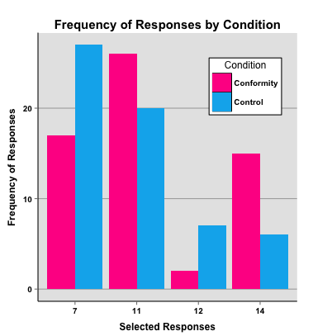
Online Decision Making Using Survey Monkey as an Experimental Platform
Methods & Stimuli:
Participants agreed to the informed consent, responded to optional demographic questions, answered a single math equation, and were debriefed via Survey Monkey. Participants with odd numbered months of birth were assigned to the Control Condition. Those with even numbered months of birth were assigned to the Feedback Condition.
2³-8÷4×2+7=?
The Control Condition displayed only the equation. The Feedback Condition displayed manipulated percentages along with the equation:
7 (3.3%) of participants have selected this answer.
12 (17.8%) of participants have selected this answer.
11 (23.7%) of participants have selected this answer.
14 (55.2%) of participants have selected this answer.
Abstract:
Handsaker and Reese (2015) proposed that participants would conform in an online environment by incorrectly responding to a math equation. This study was completed using Survey Monkey as an experimental platform. Participants were assigned to a condition group based on their birth month. A single equation (stimuli) was solved. The equation appeared with manipulated feedback in the experimental condition. Results suggested that participant response was not independent of condition. Participants in the Conformity group conformed in their responses significantly more than those in the Control group.
Results & Discussion:
Data from 120 participants were used in the analysis, 2 responses were discarded for non response.
A significant effect was found using a Pearson's Chi-squared test; Chi-Square(3)=9.69, p=.02.
Response was not independent of condtion group.
Compared to those in the Control Condition, participants in the Feedback Condition conformed more frequently, more than twice as often, to the incorrect response of 14 (Refer to graph).
The importance of this study is the demonstration of conformity in an online environment to objective material. These results will be of value to greater understanding of authenticity and conformity in online education, an ever expanding phenomenon nationwide.
Introduction:
The purpose of the present study was to replicate findings from a classic conformity study (Asch, 1956). Asch studied group conformity using the line test. Informants were used to influence the subject’s response on line lengths. The present study was also designed to further explore findings from a study of consumer recommendations on individual preference in an online environment (Zhu & Huberman, 2014). In this study the material was subjective. The present study aimed to provide evidence of conformity when objective stimuli is used in an online environment.
References:
Asch, S. E. (1956). Studies of independence and conformity: I, A minority of one against a unanimous majority. Psychological Monographs: General and Applied, 70. doi:10.1037/h0093718
Handsaker, S. M., & Reese, S. (2015) Online Decision Making Survey. https://www.surveymonkey.com/s/GXH5KGK
Zhu, H., & Huberman, B. A. (2014). To switch or not to switch: Understanding social influence in online choices. American Behavioral Scientist, 58, 1329-1344. doi:10.1177/0002764214527089

